Slide 1
Visual Design Building Blocks

Slide 2
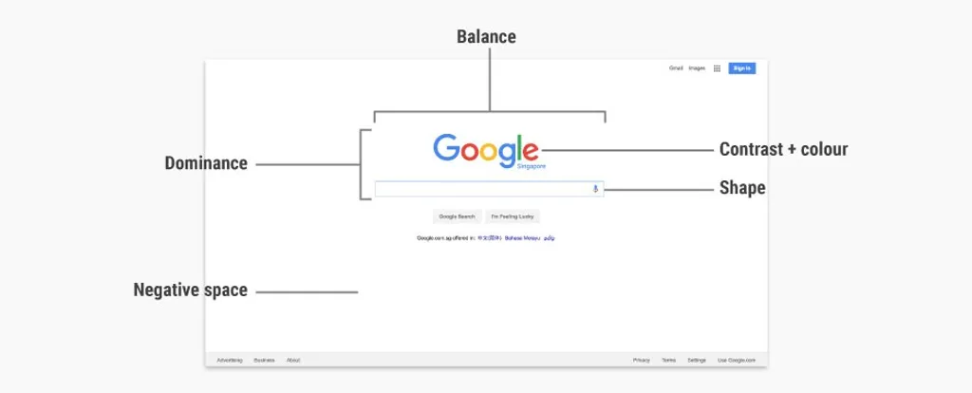
Visual Design Building Blocks

Slide 3
Visual design is about creating and making the general aesthetics of a product consistent.
Fundamental elements of visual design is needed to create the aesthetic style , arranging them according to principles of design.
These elements and principles together form the building blocks of visual design, and a firm understanding of them is crucial in creating a visual design of any product.

Slide 4
Elements of Visual Design

Slide 5

Line
Lines are strokes connecting two points, and the most basic element of visual design.
Use line to create shapes, and when repeated it can form patterns that create textures.

Slide 6
A line connects two points and is the simplest element of design.
Lines can possess a large variety of properties that allow us to convey a range of expressions. For example, lines can be thick or thin, straight or curved, have uniform width or taper off, be geometric (i.e., look like they are drawn by a ruler or compass) or organic (i.e., look like they are drawn by hand).

Slide 7
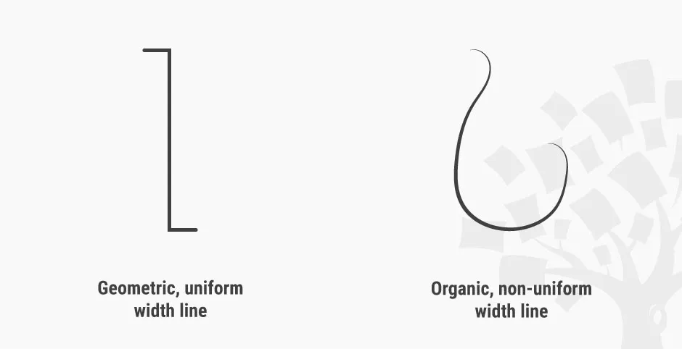

Slide 8
Lines are simple, but can convey different emotions by using different properties.

Slide 9

A line can also be implied: that is, suggested by forming an invisible connection between other elements. In the logo of the Interaction Design Foundation, for instance, the words “Interaction Design Foundation” around the tree connect to create a semicircular implied line.
The words “Interaction Design Foundation” form an implied semicircular line in our logo.

Slide 10

Shape
Shapes are self-contained areas, usually formed by lines (although they may also be formed by using a different colour, value or texture).
A shape has two dimensions: length and width.

Slide 11
We can form shapes using lines, or by using differences in colour, texture or value.

Slide 12
Negative/White Space
Negative space (also known as white space) is the empty area around a (positive) shape.
The relation between the shape and the space is called figure/ground, where the shape is the figure and the area around the shape is the ground.
When designing positive shapes, it designes also negative spaces at the same time.
Negative space is just as important as the positive shape itself — because it helps to define the boundaries of the positive space and brings balance to a composition.

Slide 13
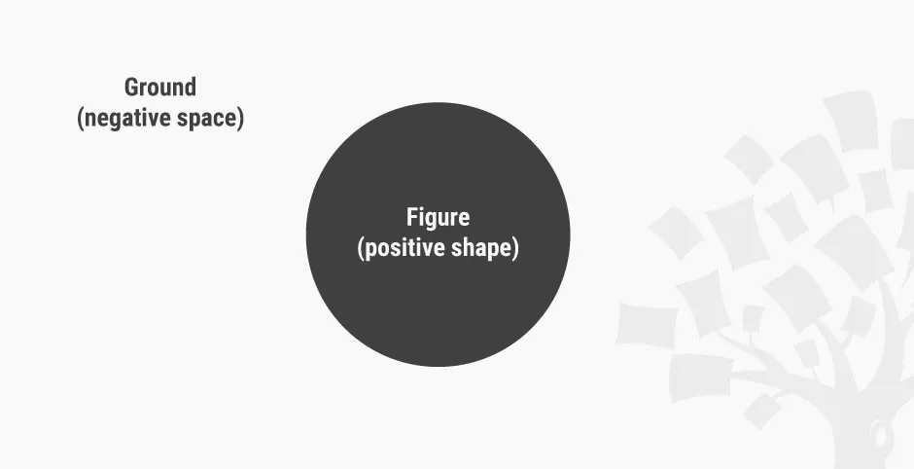

Slide 14
Negative space, also called white space, is the empty area around a positive shape. You can choose to see this as a blue ball set against a light blue rectangle — or, is it a light blue rectangle with a hole in it?

Slide 15

Some designs make use of negative space to create interesting visual effects. For example, the famous World Wide Fund for Nature (WWF) logo makes use of the confusion between positive shape and negative space to create the image of a panda.
WWF’s logo doesn’t explicitly draw out the entire panda: it cleverly uses negative (white) space around the black shapes to suggest the rest of the panda.

Slide 16
Volume
Volume applies to visuals that are three-dimensional and have length, width and depth.
We rarely use volume in visual design, because most digital products end up being viewed on a 2D screen, although some apps and websites do use 3D models and graphics. (Technically, though, 3D images viewed on a 2D screen are still 2D images.)

Slide 17

Volume has 3 dimensions: length, width and depth. This image is a simulation of volume in 2D graphics.

Slide 18
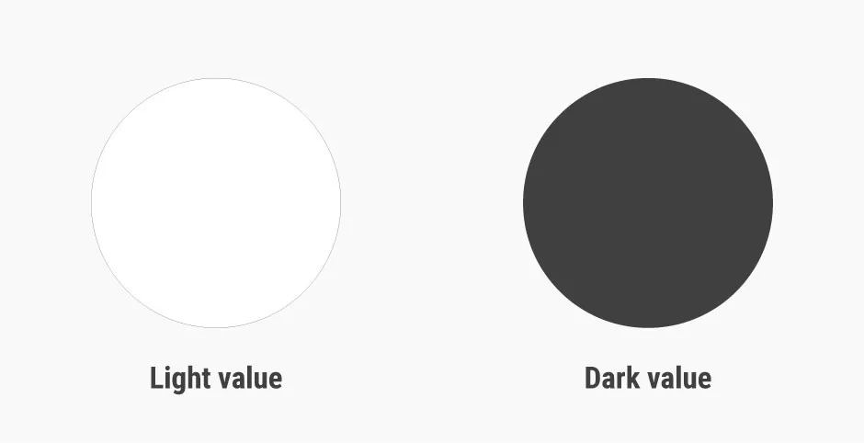
Value
Value, quite simply, describes light and dark.
Light value vs. dark value: value describes lightness and darkness.

Slide 19
A design with a high contrast of values (i.e., one which makes use of light and dark values) creates a sense of clarity, while a design with similar values creates a sense of subtlety.
We can also use value to simulate volume in 2D, for instance, by using lighter values where the light hits the object and darker values for shadows.

Slide 20

Differences in values create clear designs, while designs using similar values tend to look subtle.

Slide 21
Color

Slide 22
The Importance of Color in Data Visualization
Colors speak a language louder than words and communicate with us on an emotional level.
The challenge is to use the power of color effectively to communicate the message you want to send.
Data visualization is very important in business today – it makes patterns more visible, digestible and clearer.
It can improve the way you tell a story and color is an important part of this.
Color sets the stage for how your data makes people feel.

Slide 23
The meaning of colors
Colors create a chemical reaction in the brain that produces an emotional response.
They trigger thoughts, memories and associations to places, people, and events.
Colors with long wavelengths, like red, have a faster recognition response in the brain.
Colors with a shorter wavelength, like blue, are more soothing and can actually lower blood pressure and pulse rate. Yellow is a middle wavelength color that commands attention.
The meanings of colors affect how viewers perceive data. For example, if you want to create an awesome slide presentation, using the right colors is essential.
A light blue could help your audience to relax whereas too much yellow could generate anxiety.

Slide 24
The meaning of colors
It is worth paying attention to some of the research done into just how different colors affect emotions.
For example, even a light red and a dark red can convey very different emotions. Light red conveys love, and joy whereas dark red conveys anger, passion and confidence.
Businesses often make extensive use of color to influence the way customers feel. For example, cafes will use colors like orange and brown on the walls to make customers feel relaxed and at home.
A brand like thepensters uses an effective combination of blue, white and yellow on a black background to draw attention to key features on their website.

Slide 25
Creating associations through color
Color lets you set the mood and helps you to tell a story. In a visualization of drone strike victims in Pakistan, Pitch Interactive uses red drops very effectively. The association of red with the color of blood makes it work.
When Professor Klaus Schulte created a visualization of how Germans have dominated the Olympic sport of Luge, he used the black, red and yellow of the German flag. The blocks of color were immediately recognizable.

Slide 26
Choosing your colors
Neil Patel reports that 52% of the time, poor color choice and other inferior design choices make users leave a website and never go back. In data visualization, colors have the same effect and choosing the right colors is very important. Choosing your colors depends on various factors and aesthetics, testing and science should all play a part.
Your Target Audience: You need to know who they are, what they care about and how they will be affected by the colors you choose. For example, color means different things in different cultures.
Derek Morgan, a writer at essayshark reviews, says he was surprised to discover just how different the perception is of the color yellow in different cultures. In Japan, yellow is associated with courage but in certain parts of China, it can have vulgar connotations.
Color perceptions are influenced by age, race, social class, religion and gender. Researching the cultural associations of your target audience with each color is important.

Slide 27
Choosing your colors
Appropriateness: Certain colors are more appropriate to some industries than to others. Sometimes, colors just feel wrong to us because they don’t match our expectations.
For instance, we don’t expect to see financial institutions using bright yellow or orange. We don’t expect to see landscaping companies using these colors either.
Financial institutions often use the color blue because it communicates stability and authority, values customers expect from those who handle their money. Red may be suitable for a dating service whereas green is usually associated with nature and the environment.

Slide 28
Improve data visualization by using color
You can’t just throw color in haphazardly as you may end up distracting viewers rather than evoking the feelings you want. You need to use color carefully in ways that get your point across.
Influence overall feel and give depth: Using the right colors is important to get your viewers feeling how you want them to feel about your data. Colors can create a cheerful mood or convey a sense of calmness. They can evoke feelings of creativity, purity or sophistication.
Make important elements stand out: Using the same colors for everything is not only dull and uninteresting but is also confusing to viewers. Color helps you to highlight the most important aspects of your message and simplify complex graphs.
By using contrasting colors, such as blue and orange, if you’re comparing two data sets, you can simplify data and help viewers to see the big picture. Using gray for less important chart elements can make highlight colors stand out more.
Use contrasting colors to make data jump out and grab attention. For example, if you want to emphasize a piece of data in a bar graph, you will make it bright red in a sea of gray.

Slide 29
Improve data visualization by using color
Create contrast: Using a great range of colors is no good if viewers can’t read the data. You want to make sure that viewers are able to read your data on their screens, even if you use light colors like gray.
This is especially important for text as the smaller it is, the higher the contrast to the background needs to be for it to be readable.
Avoid using bright colors for backgrounds. Consider giving small lines a high contrast in hue or brightness so they are easy to distinguish. Testing a presentation on a projector before giving a presentation is important because the colors may look quite different from those on your laptop screen or phone.

Slide 30
Improve data visualization by using color
Use colors consistently: If you have certain variables that you repeat across different sets of data, you should use the same colors where possible. A sense of consistency helps viewers to relate.
Use gradients when you can: Gradients offer a great way to compare and contrast data and feel natural when viewers see them. If a gradient indicates a scale of low to high, light colors should represent the low values and darker colors, the high values. This is intuitive for the audience.
Having unrelated colors can make data more difficult to read. If you’re unsure about using gradients but want to try your hand, you could try using the ColorBrewer palettes.

Slide 31
Improve data visualization by using color
Using color strategically is more than just choosing what looks good to you. You should never select colors because you think they are trendy or cool or they’re the colors you always favor.
You need to choose them carefully by understanding the meaning behind them, taking your audience into consideration and knowing what’s appropriate for your brand. The value of picking the right colors for your data visualization should never be underestimated.

Slide 32
Color
Colour is an element of light. Colour theory is a branch of design focused on the mixing and usage of different colours in design and art.
In colour theory, an important distinction exists between colours that mix subtractively and colours that mix additively.

Slide 33
In paint, colours mix subtractively because the pigments in paints absorb light.
When different pigments are mixed together, the mixture absorbs a wider range of light, resulting in a darker colour.
A subtractive mix of cyan, magenta and yellow will result in a black colour.
A subtractive mix of colours in paint and print produces the CMYK (i.e., Cyan, Magenta, Yellow and blacK) colour system.

Slide 34
In digital design, where the product shows up on a screen, colours mix additively, since the screen emits light and colours add to one another accordingly.
When different colours are mixed together on a screen, the mixture emits a wider range of light, resulting in a lighter colour.
An additive mix of red, blue and green colours on screens will produce white light. An additive mix of colours on digital screens produces the RGB (i.e., Red, Green, Blue) colour system.

Slide 35
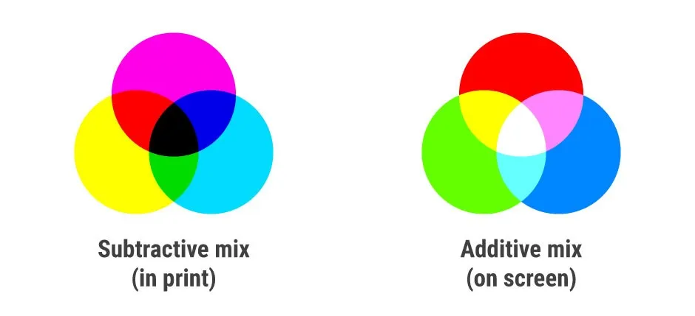

Slide 36
The subtractive mix of colours in paint and print produces the CMYK colour system. The additive mix of colours on digital screens produces the RGB colour system.

Slide 37
Use colours in visual design to convey emotions in and add variety and interest to our designs, separate distinct areas of a page, and differentiate our work from the competition.

Slide 38

Texture
Texture is the surface quality of an object.
Texture can be created by a repeated pattern of lines, or by using tiled images of textures. Above, the diagonal lines add a ‘grip’ effect to an otherwise ‘smooth’ rectangle.

Slide 39
two types of textures: tactile textures, where you can feel the texture, and implied textures, where you can only see — i.e., not feel — the texture.
Most visual designers will work with implied textures, since screens (at least as far as the state of the art had pushed them by the mid-2010s) are unable to produce tactile textures.

Slide 40

Read Yourself Slide
The app icon designs in iOS 6 and earlier mimic the glossy texture of glass to incite users to tap them.
Later, Apple (in)famously introduced a linen fabric texture to much of its user interface.
With the popularity of flat design (a minimalist style that features clean spaces and two-dimensional, flat illustrations), the use of textures in visual design would greatly decrease by the mid-2010s — although they can still be very useful.

Slide 41
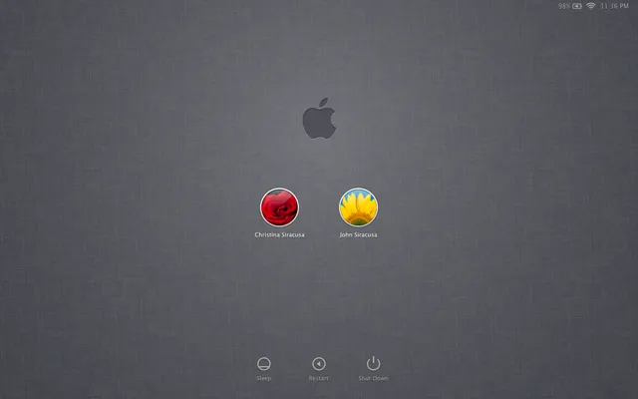
iOS 1-6 app icons feature a glossy texture so that they look like actual buttons.
Around 2011, Apple introduced a widespread use of linen texture (which first appeared on iOS) in all of its operating systems.

Slide 42
Principles of Design
The elements of visual design — line, shape, negative/white space, volume, value, colour and texture — describe the building blocks of a product’s aesthetics.
On the other hand, the principles of design tell us how these elements can and should go together for the best results.
Many of the principles below are closely related and complement one another.

Slide 43
Partner and chief research and development officer at the Applied Management Sciences Institute William Lidwell, in his landmark and widely referenced book Universal Principles of Design, explains:
“The best designers sometimes disregard the principles of design. When they do so, however, there is usually some compensating merit attained at the cost of the violation. Unless you are certain of doing as well, it is best to abide by the principles.” – William Lidwell

Slide 44
Unity
Unity has to do with creating a sense of harmony between all elements in a page. A page with elements that are visually or conceptually arranged together will likely create a sense of unity.

Slide 45
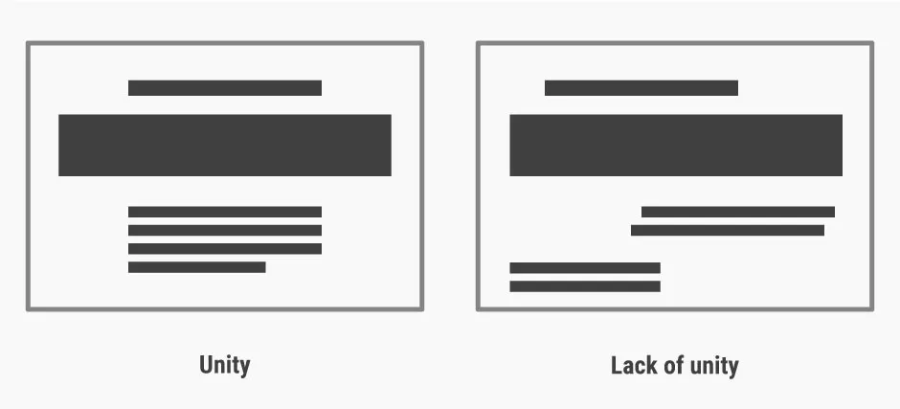
A lack of unity in designs can create a sense of unease and chaos. Our eyes govern our judgements.

Slide 46
Gestalt
Gestalt refers to our tendency to perceive the sum of all parts as opposed to the individual elements.
The human eye and brain perceive a unified shape in a different way to the way they perceive the individual parts of such shapes.
In particular, we tend to perceive the overall shape of an object first, before perceiving the details (lines, textures, etc.) of the object.

Slide 47

Gestalt is the reason that we can see a square, circle and triangle even though the lines are not complete. We see the whole formed by the dotted lines first, before perceiving the separate dotted lines in each of the images.

Slide 48
The WWF logo, shown earlier, is an example of making use of the principle of gestalt to create interesting designs. By placing the parts of a panda near one another and strategically, the design makes use of our tendency to view the whole of an image rather than its parts, thereby creating an illusion of a panda.

Slide 49
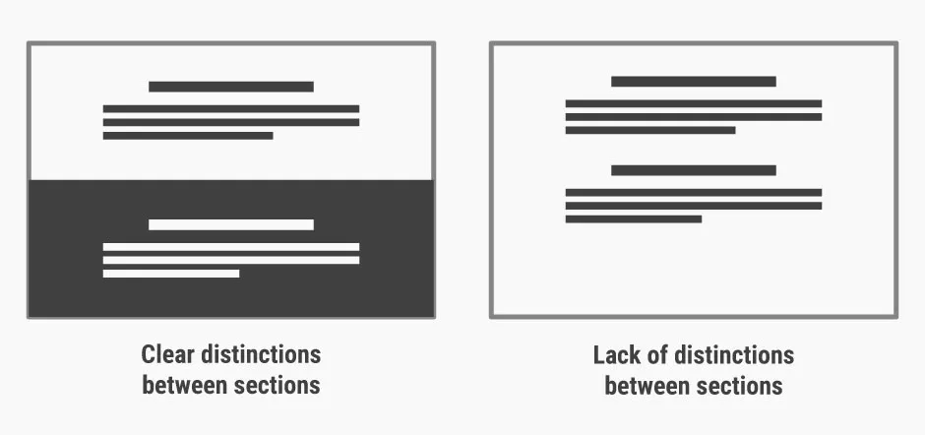
Designs with clear sections are easier to process and scan than those without clear distinctions between sections — especially if the sections are conceptually distinct.

Slide 50
Hierarchy
Hierarchy shows the difference in importance of the elements in a design. Colour and size are the most common ways we can create hierarchy — for instance, by highlighting a primary button, or using larger fonts for headings.
Items that appear at the top of a page or app also tend to be viewed as having a higher hierarchy than those appearing below.

Slide 51
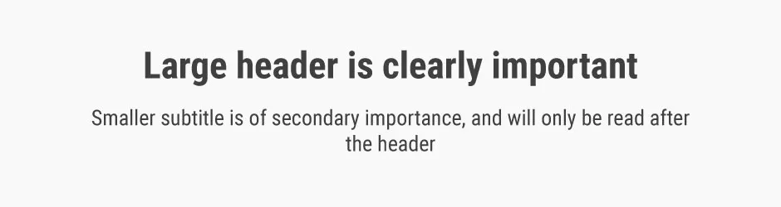
Font size and style is one of the ways to establish hierarchy.

Slide 52
Balance
Balance is the principle governing how we distribute the elements of a design evenly. Balanced designs tend to appear calm, stable and natural, while imbalanced designs make us feel uneasy.

Slide 53
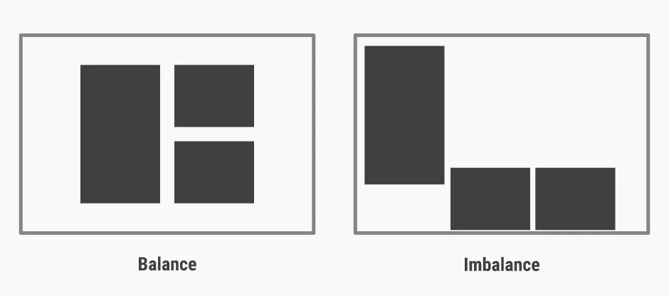
Balanced designs appear stable, while imbalanced designs seem unsustainable and unnatural.

Slide 54
Read Yourself Slide
Balance can be achieved by having symmetry in the design (for instance, having a webpage with centralised text and images). However, you can also achieve balance without symmetry — perhaps unsurprisingly, this is known as asymmetrical balance. We achieve asymmetrical balance when we arrange differently sized elements in a way that results in unity. We can imagine a centre point of the design and distribute the elements in a way that creates balance.

Slide 55
Contrast
use contrast to make an element stand out by manipulating differences in colour, value, size and other factors.
For instance, as designers (be it in logo design, UI design, etc.), we often use the colour red to make certain elements stand out.
In iOS, red often appears in the “Delete” action to signify that an (often) irreversible action is about to occur.

Slide 56
On the other hand, green is often something we use (at least in Western design) in positive actions such as “Go” and “Accept” — thus highlighting that we cannot ignore the cultural meaning of colours when designing for contrast.
If you’re designing for a client in a far-off land, learn about and adjust your work to conform to the cultural considerations. For instance, ask yourself, “Is their red lucky or angry?” or “Is their black businesslike or funerary?”

Slide 57
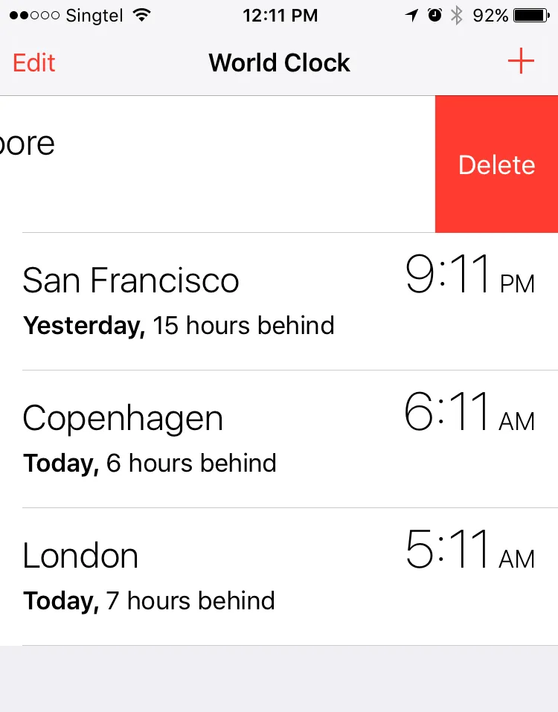
Red, a colour with high contrast, is used widely in iOS for the “Delete” function.

Slide 58
Scale
Scale describes the relative sizes of the elements in a design. By using scale to make an element larger than others appearing with it, you can emphasise that element.
Not only can you make an element stand out this way—you can also use scale to create a sense of depth (since nearer objects appear larger to the human eye).
Exaggerated scales of images also add a certain level of interest and drama to them.

Slide 59

Scale can be used to create a hierarchy for and add emphasis to certain elements on a design.

Slide 60

Dominance
Dominance creates focus on a single element. We can use colour, shape, contrast, scale, and/or positioning to achieve this. For instance, most websites have a main “hero” image, which uses dominance to appeal to users, drawing them to it naturally.
Dominance can be established by using positioning, shape and colour, among many other factors.

Slide 61
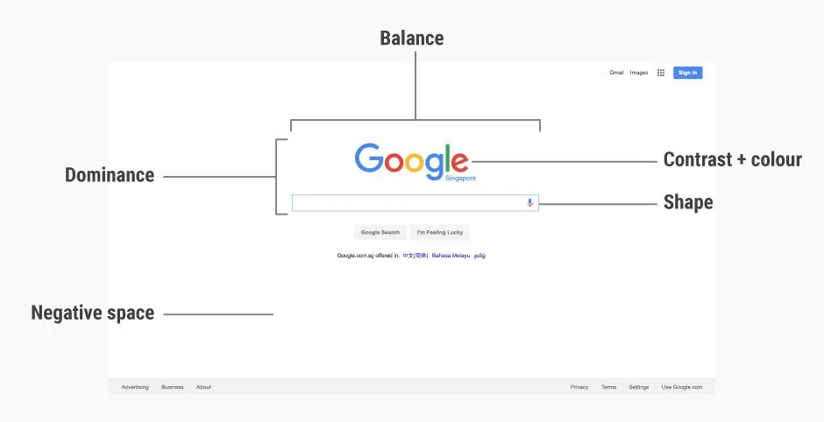
Revisiting

Slide 62
Dominance: The large Google logo and search box gives it dominance, making it the core (and to most, sole) focus of the entire page.
Contrast (and colour): Google’s logo uses bright (mostly primary) colours, and these mix well, forming a visually pleasing logo. The logo also has sufficient contrast against a white background, making it stand out on the page.
Shape: The search box uses a rectangular shape to delineate the search field, making it very usable.
Negative space: Google’s homepage is predominantly made out of negative space, which makes the search box (the main function of the page) the centre of attention. The negative space also works well for the page, as it acts like a blank sheet of paper before users type in their search terms.
Balance: The page is almost vertically symmetrical, resulting in a sense of balance that is very pleasing and calm to look at.

Slide 63
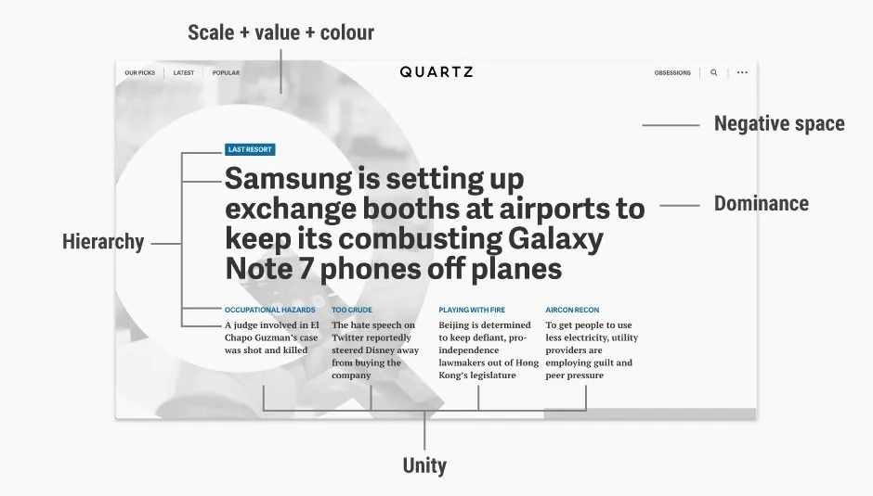
Quartz’s homepage

Slide 64
It’s easy to admire the effect as a whole without looking past it at the nuts and bolts—the elements that are set together so well and according to age-old principles so as to create that ‘wow’ effect.
Dominance: The main news story immediately catches your eyes because its large, bold font makes it dominant on the homepage.
Hierarchy: The homepage uses a clear hierarchy to establish the relative importance of various elements. The main story, with the largest text and bolded weight, has the highest hierarchy. The next four stories, positioned below the main story, have smaller fonts to show their subordinate hierarchy under the main story.
Scale, value and colour: Quartz’s homepage features a large (full page height) “Q”, which is a mask of the hero image for the main story. The large “Q” quickly establishes the identity of the website (since “Q” stands for “Quartz”) with the use of scale. However, the relative light value and greyscale colour of the “Q” makes it fade into the background, thus bringing the overall focus to the headline of the main story instead.
Negative space: Most of the homepage is negative space, which allows the content to shine through. When the mouse is brought over the main story headline, the “Q” mask disappears, filling the negative space with the featured image. This is an example of how a unique play of negative space can stimulate interest in a website’s design.
Unity: Quartz uses a grid system in its website to create a sense of unity. For instance, the four stories have equal width and are uniformly spaced, creating a sense of orderliness and structure.

Slide 65
Color Palettes and Effects
All marks have a default color, even when there are no fields on Color on the Marks card. For most marks, blue is the default color; for text, black is the default color in tableau.

Slide 66
Categorical Palettes
When you drop a field with discrete values (typically a dimension) on Color on the Marks card, Tableau uses a categorical palette and assigns a color to each value of the field.
Categorical palettes contain distinct colors that are appropriate for fields with values that have no inherent order, such as departments or shipping methods.

Slide 67
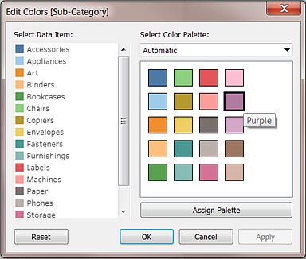
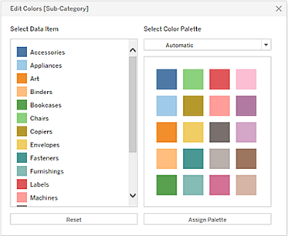
Tableau Desktop version | Web version

Slide 68

Quantitative Palettes
When you drop a field with continuous values on the Marks card (typically a measure), Tableau displays a quantitative legend with a continuous range of colors.

Slide 69
To edit colors, click in the upper right of the color legend.
In Tableau Desktop, select Edit Colors from the context menu.
In Tableau Server or Tableau Online, the Edit Colors dialog opens automatically.

Slide 70
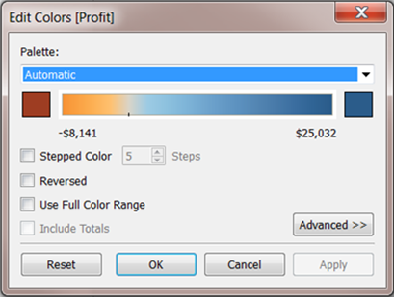
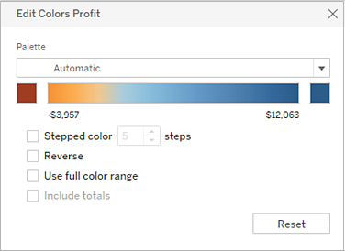
Tableau Desktop version | Web version

Slide 71
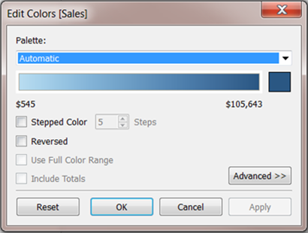
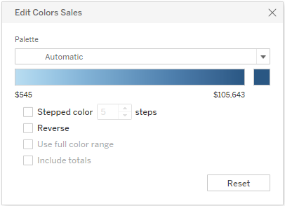
When all values are either positive or negative, the default range of values will use a single color range and the Edit Colors dialog box for the field has a square color box only at the right end of the range. This is known as a sequential palette.

Slide 72
Read Yourself Slide
The Palette drop-down list provides a range of color palettes from which you can choose. There are two types of quantitative palettes available for continuous fields:
All palettes with Diverging in the name are diverging quantitative palettes—for example, Orange-Blue Diverging.
You can choose a diverging palette for any continuous field—it isn’t necessary for the range of values to contain both positive and negative numbers.
To change the colors for a diverging palette, click one of the square color boxes at either end of the palette spectrum. Depending on whether you are authoring in Tableau Desktop or on the web, do one of the following:
In Tableau Desktop, in the color configuration dialog box (which is part of your computer’s operating system), select a color from the color picker or enter custom values.
In Tableau Server or Tableau Online, enter a custom Hex value in the Custom Color field. If the value isn't valid, no changes are made.
All other palettes are sequential quantitative palettes. To change the colors for a sequential palette, click the square color box at the right end of the palette spectrum to either open the color configuration dialog box (Tableau Desktop), or enter a custom Hex value in the Custom Color field (Tableau Server or Tableau Online).

Slide 73
Options for quantitative palettes
Stepped Color
Select Stepped Color to group values into uniform bins, where each bin is associated with a color. Use the spin control to specify how many steps (bins) to create.
For example, for a range of values from 0 to 100 you could specify five steps to sort values into five bins (0-20, 20-40, etc.).

Slide 74
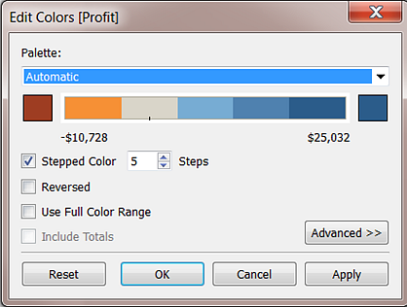
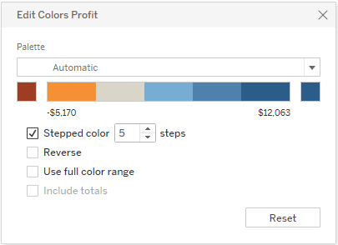
If a diverging color palette is selected, the point where the palette transitions between colors is shown on the color ramp with a small black tick mark. When the number of steps is odd, the mark is placed in the middle of the transitional step. When the number of steps is even, the mark is placed at the boundary between the steps where the color changes.

Slide 75
Reversed
Select Reversed to invert the order of colors in the range. For example, if you want lower values to have a darker intensity in a sequential palette, reverse the palette. For a diverging palette, reversing the color palette means swapping the two colors in the palette, in addition to inverting the shades within each color range.

Slide 76
Use Full Color Range
With a diverging (two-color) palette, you can select to Use Full Color Range.
So if the range is from -10 to 100, the color representing negative numbers will be adjusted to change in shade much more quickly than the color representing positive numbers.
If you don't select Use Full Color Range, Tableau assigns the color intensity as if the range of values was from -100 to 100, so that the change in shade is the same on both sides of zero.
This means there will be much less change on the negative side, where actual values only range from -10 to 0, than on the positive side, where values range from 0 to 100.

Slide 77
The image on the left below shows a red-green diverging color palette for values from -858 to 72,986.
Without using the full color range, -858 (associated with the small box at the lower right of the chart) shows as gray, because -858 is only about 1% as far to the negative side as 72,986 is to the positive side.
When the full color range is used, as in the image on the right, -858 shows as a dark red, equal in intensity to the maximum positive value.

Slide 78
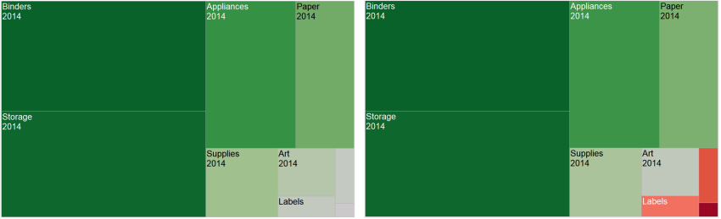

Slide 79
Include totals
Select Include Totals to include totals, sub-totals and grand totals in the color encoding. This option only applies when total values are included in the view.

Slide 80
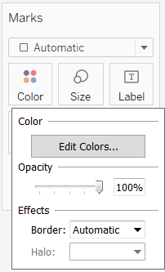
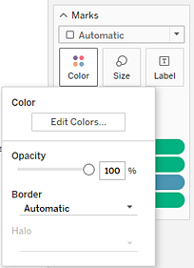
Configure Color Effects
Click the Color drop down on the Marks card to configure additional Color settings not related to the actual colors shown.

Slide 81
Opacity
Modify the opacity of marks by moving the slider.
Adjusting opacity is especially useful in dense scatter plots or when you are looking at data overlaying a map or background image. As you slide the slider toward the left, marks become more transparent.

Slide 82
Mark borders
By default, Tableau displays all marks without a border. You can turn on mark borders for all mark types except text, line, and shape. On the Color drop-down control, select a mark border color.

Slide 83
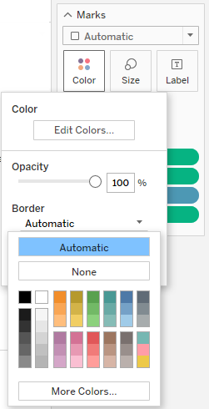
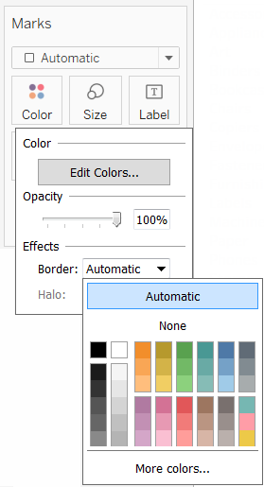

Slide 84
Borders can be useful for visually separating closely spaced marks. For example, the views below show a scatterplot with mark borders turned on (left) and turned off (right). When borders are turned on, marks are easier to distinguish in areas where they are tightly clustered.

Slide 85
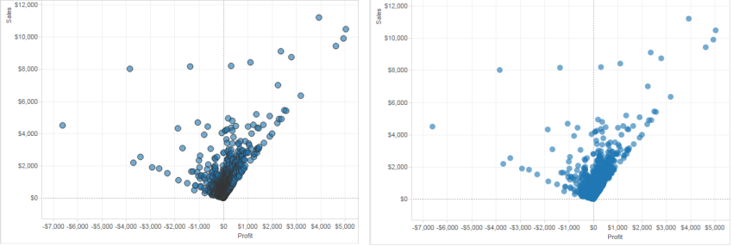

Slide 86
When you are viewing a large number of color-encoded small marks, it is usually better to leave mark borders off. Otherwise borders can dominate the view, making it difficult to see the color encoding.

Slide 87
For example, the views below show bars that are segmented by a large number of color-encoded dimension members. With mark borders turned on (right), some of the narrower marks are difficult to identify by color. With borders turned off (left), the marks are easy to distinguish.

Slide 88
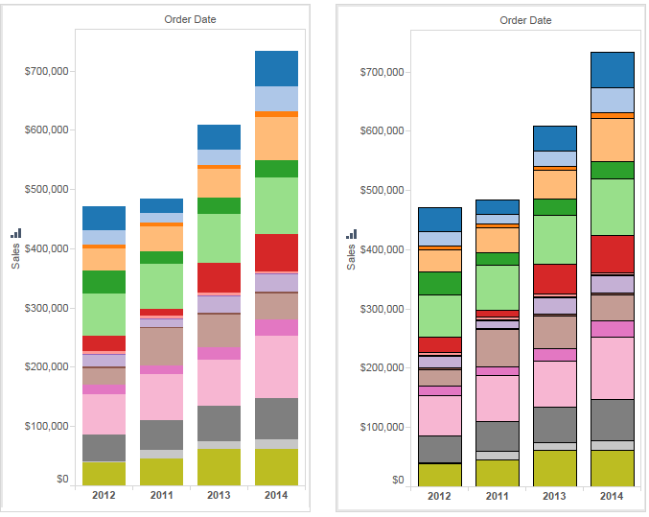

Slide 89
Mark halos:
To make marks more visible against a background image or map, surround each mark with a solid contrasting color called a halo. Mark halos are available when you have a background image or a background map. On the Color drop-down control, select a mark halo color.

Slide 90
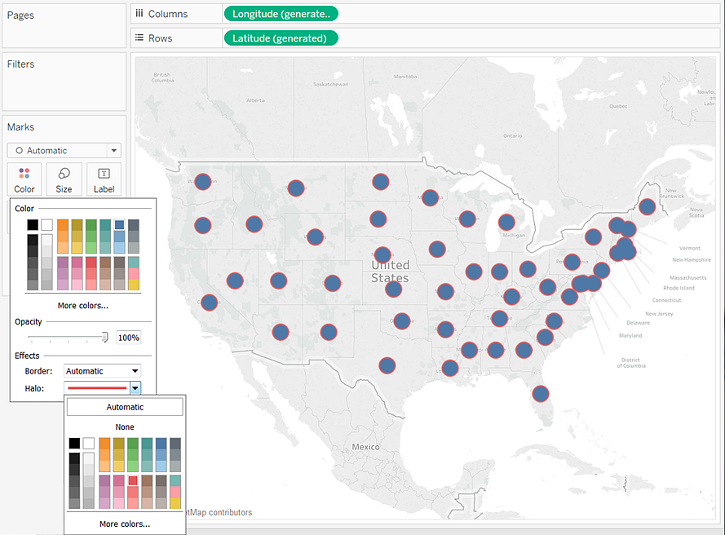

Slide 91
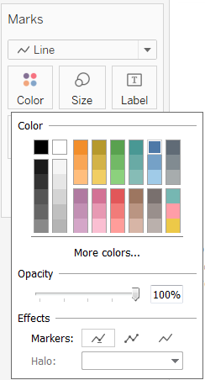
Markers
In Tableau Desktop, when you are using the Line mark type, you can add a marker effect to show or hide points along the line. You can show selected points, all points, or no points. On the Color drop-down control, select a marker in the Effects section.

Slide 92
The Truth About the Color Green
Green represents ‘go’ in traffic signals, railway signals and ship signals. It is known as a safe color worldwide which is why first-aid equipment is often green. Fire escape exit signs are green in most countries, although some are red.
Green is the color used for night vision goggles because the human eye is most sensitive and able to distinguish the most shades in that color.
The color green is often used as a symbol of sickness, you’ll most likely have noticed this in cartoons; the character often has a green face when being sick.
In North American stock markets, green is used to indicate a rise in stock prices, however In East Asian stock markets, green indicates a drop in stock prices.
Green has long been a symbol of fertility and was once the preferred color choice for wedding gowns in the 1400’s.

Slide 93
The Truth About the Color Green
In high schools in the United States during the 1960s, it was believed that if someone wore green on Thursdays, it meant that they were gay.
Green is the national color of Ireland.
Green was a sacred color to the Egyptians representing the hope and joy of spring. The floors of the temples were green.
Suicides dropped by 34% when London’s Blackfriar Bridge was painted green.
Kermit the Frog doesn’t find it easy bein’ green!

Slide 94
The Truth About the Red color
Red represents ‘STOP’ in traffic signals, railway signals and ship signals.
Red is a prime example of a “hostile” color. That doesn’t mean red brings out negative emotions in people. It means that it attracts attention.
In nature, red can have several connotations, among them danger and fear. At the same time, red can signal sexual attractiveness in many species, including humans.
Red doesn’t leave us feeling indifferent.

Slide 95
The Truth About the Red color
Red is an appropriate color to attract your audience’s attention to the main point of your presentation.
A helpful side effect of the emotional impact red has is that an audience will better remember material that’s being presented when red is used to illustrate the data.
However, it’s important to remember that moderation is key.
If all of your visuals use a red palette, your audience may start to feel agitated and even annoyed.
They may remember your presentation, but probably not in a way you want them to remember it.

Slide 96
LINES

Slide 97
LINES
Lines facilitate several purposes in data visualization.
They act as guides, they reinforce patterns, they provide direction, and they create shapes.
Like any visual element, too many lines—or lines given too much emphasis—can cause distraction or confusion in data visualization.
However,used wisely, they can be transformative.
Like color, lines should be used sparingly to reduce the amount of ink onscreen so that the data can lead the story.

Slide 98
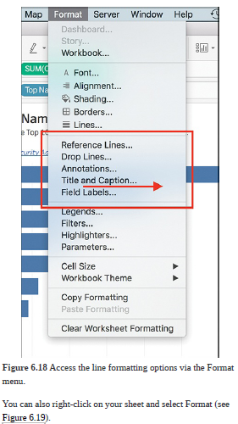
LINES

